Slide 1
Inleiding
ASP.NET MVC
Getting Started
Adding a Controller
Adding a View
Razor
HTML & TAG Helpers

Slide 2
Ontwikkelen van webapplicaties in ASP.NET?
ASP.NET MVC is a .NET framework for the rapid development of web applications.
What Is ASP.NET MVC?
• Helps keep code clean and is easy to maintain
• Handles everything from the UI to the server environment and everything in between
• Runs on Linux, Windows, and OS X
Ook wel .NET MVC of ASP.NET Core genoemd

Slide 3
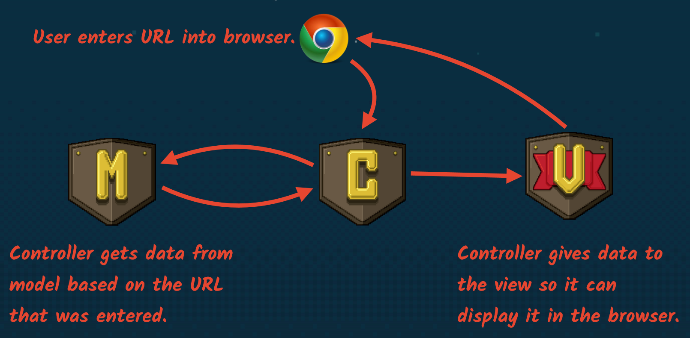
How data flows
MVC is a structural pattern for organizing code in a logical way.

Slide 4
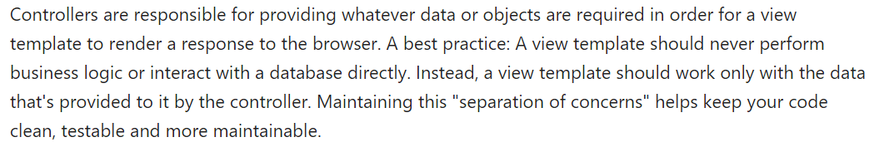
separation of concerns

Slide 5
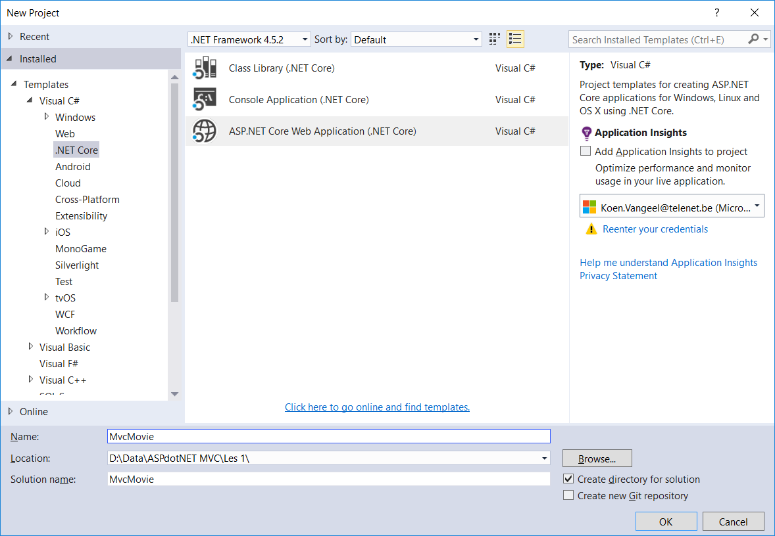
Getting started
Maak eerst een map www (bewaar hier je webapplicaties)
File | New Project
MvcMovie
Create new Git repository
(mag je uit zetten)

Slide 6
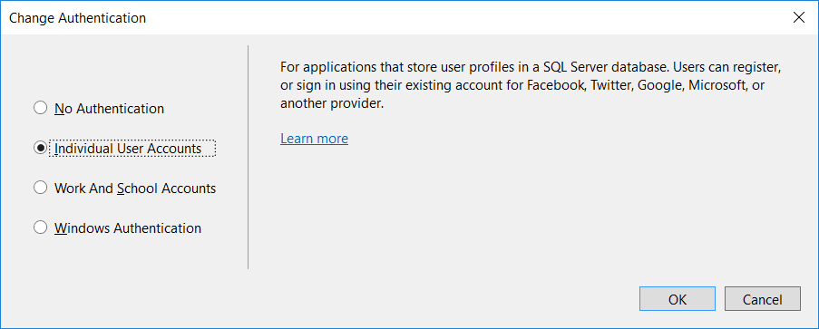
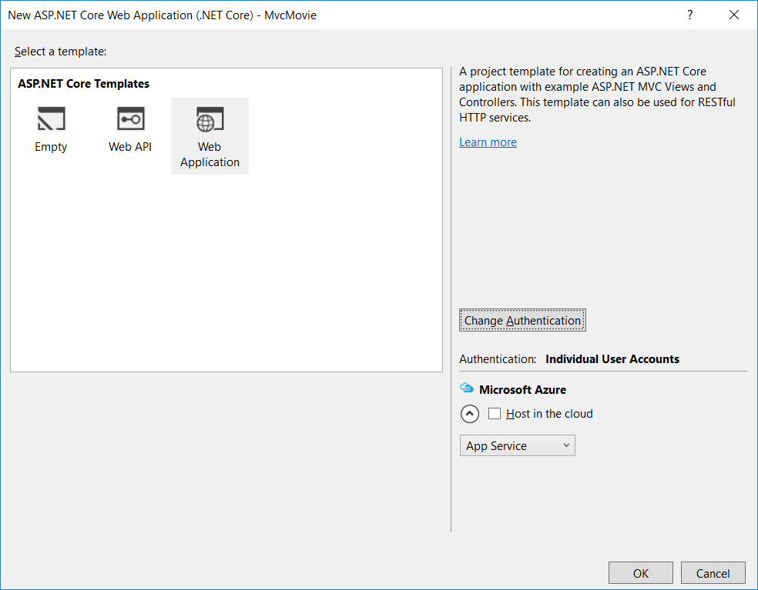
Getting Started

Slide 7
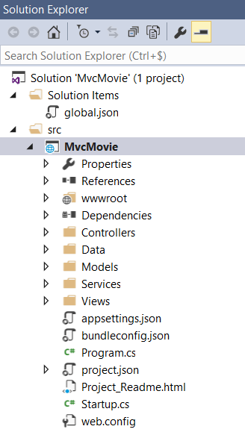
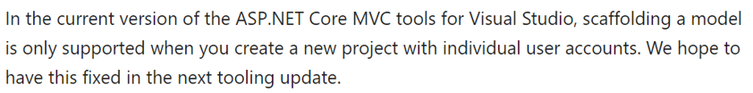
Getting started
Project bevat ook alle referenties om te werken met Enitity Framework
We gebruiken voorlopig scaffolding en bootstrap niet, maar bouwen alles van scratch op

Slide 8
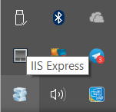
Running THE PROJECT
F5: debug-mode (start knop)
Stop knop vooraleer je aanpassingen kan doen aan je code
Ctrl-F5: non debug-mode
Aanpassingen aan de code
Refresh in browser
Compilatie van het project
Opstarten IIS Express
Oproepen van default controller in browser

Slide 9
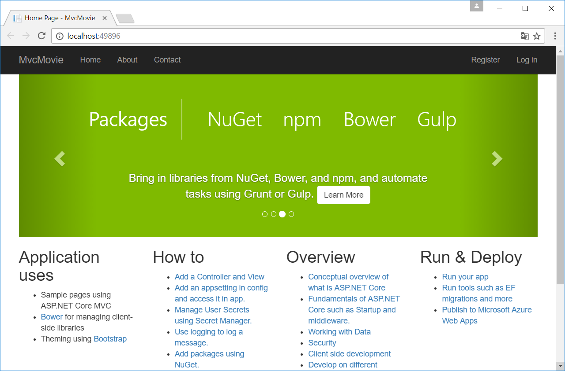
Running the project

Slide 10
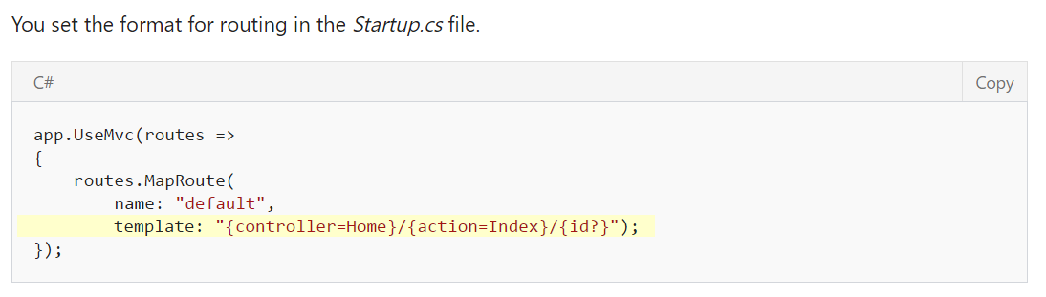
URL Segments
http://localhost:xxxx
http://localhost:xxxx/Home/Index
http://localhost:xxxx/Controller/Method

Slide 11
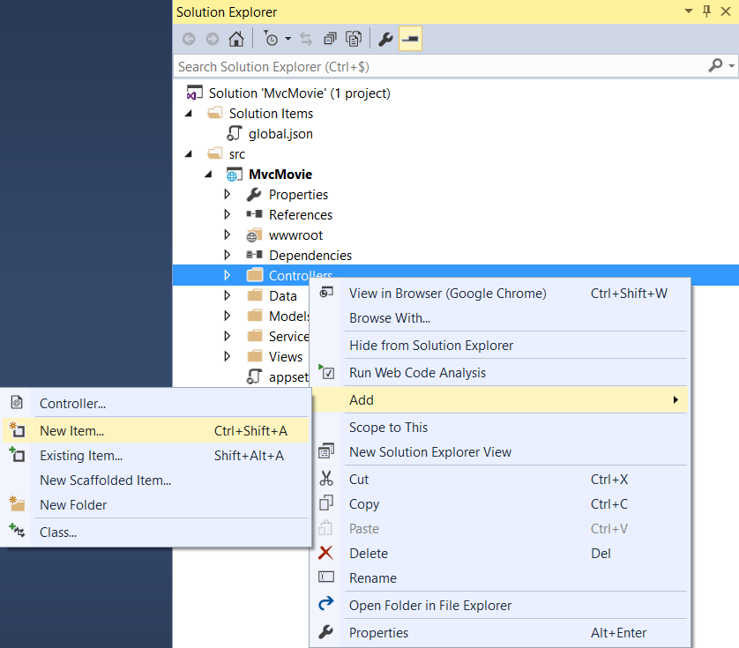
Adding a controller
Voorlopig geen Scaffolding gebruiken

Slide 12
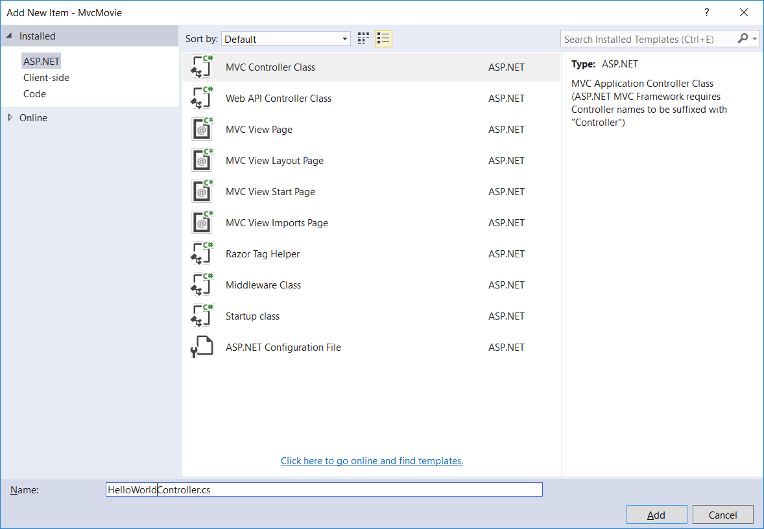
Adding a Controller
HelloWorldController.cs

Slide 13
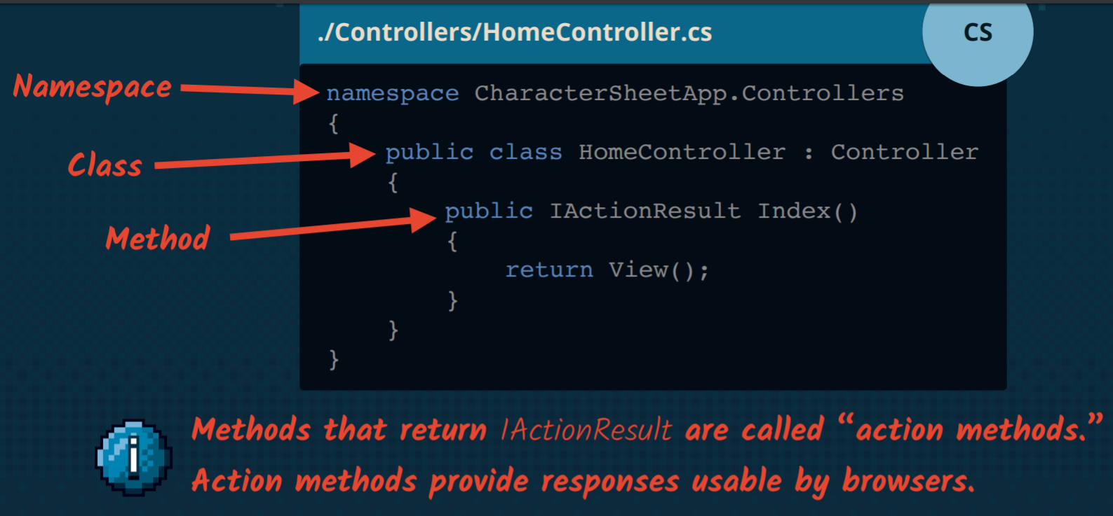
Controller

Slide 14
Class methods
namespace MvcMovie.Controllers
{
public class HelloWorldController : Controller
{
// GET: /HelloWorld/
public string Index()
{
return "This is my default action...";
}
// GET: /HelloWorld/Welcome
public string Welcome()
{
return "This is the welcome action method...";
}
}
}

Slide 15
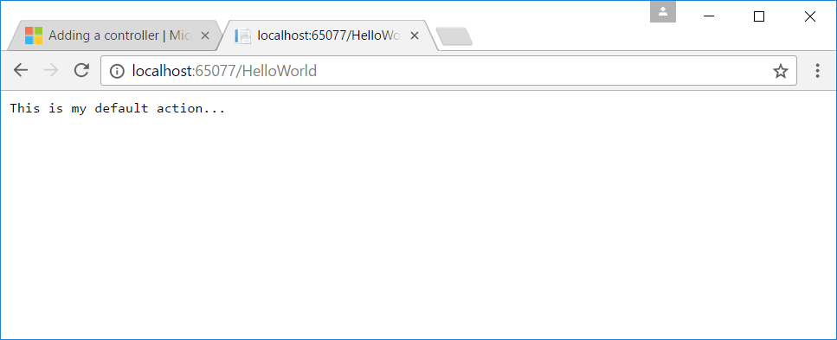
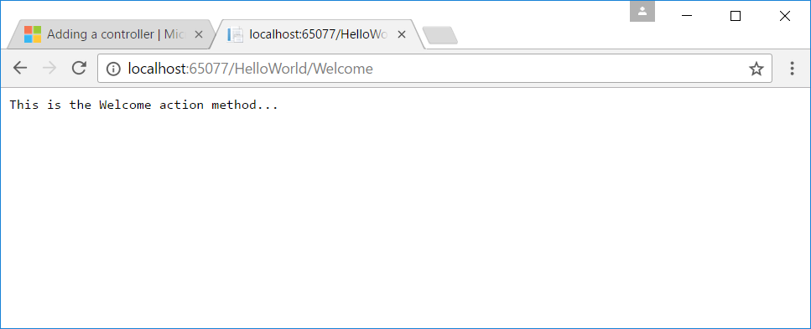
Class mapping
localhost:xxxx/HelloWorld
maps to
HelloWorldController Class

Slide 16
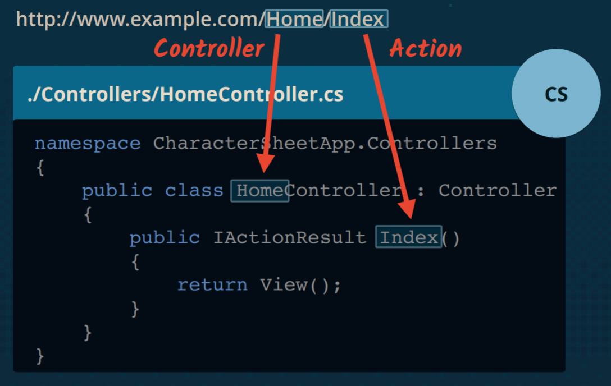
Mapping Route & Controllers

Slide 17
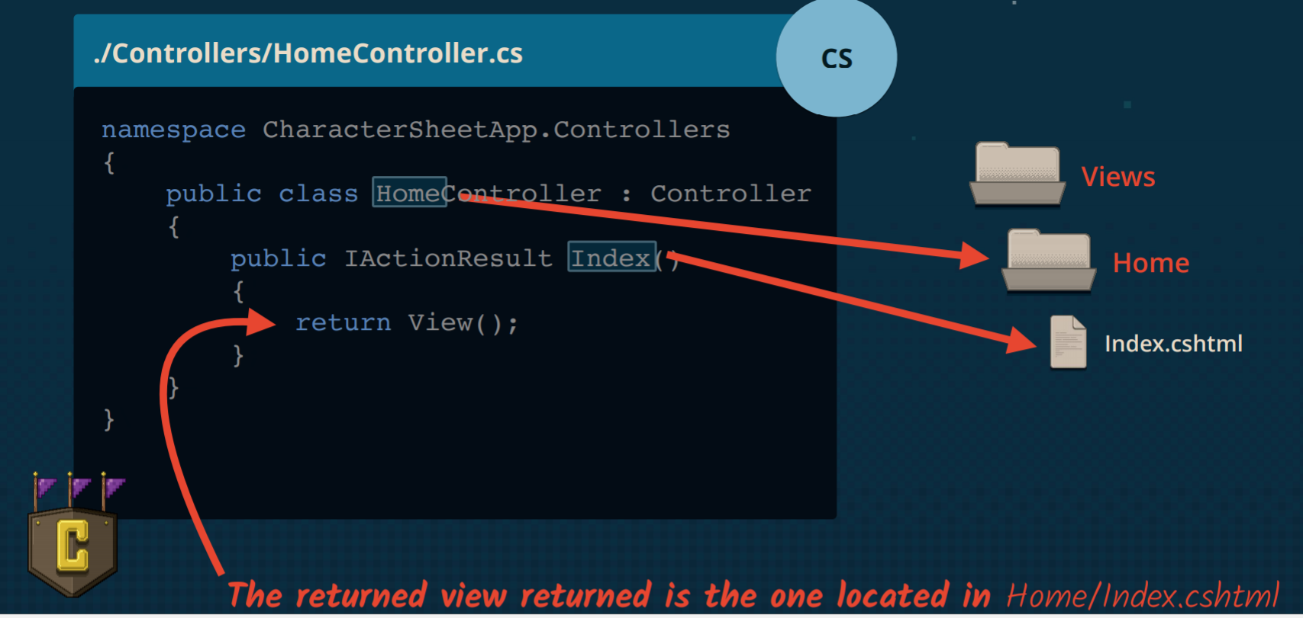
Mapping Controller - View

Slide 18
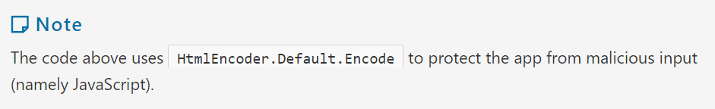
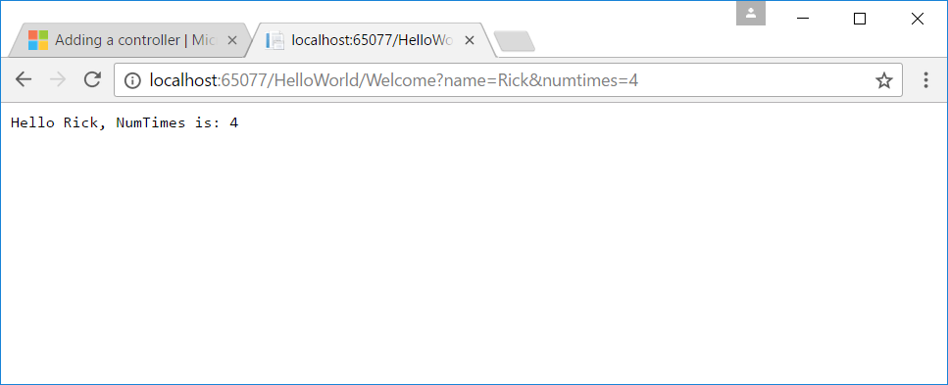
Parameters (query string ⇨ ?)
// GET: /HelloWorld/Welcome
public string Welcome(string name, int numTimes = 1)
{
return HtmlEncoder.Default.Encode($"Hello {name}, NumTimes is: {numTimes}");
}

Slide 19
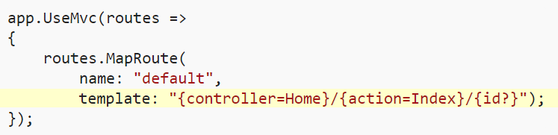
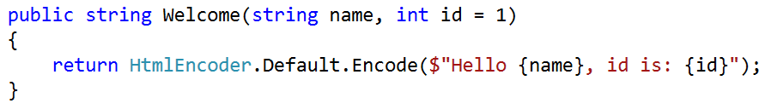
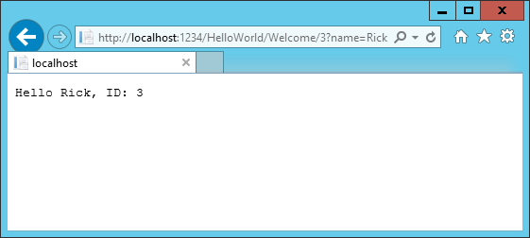
Parameters (url segment)

Slide 20
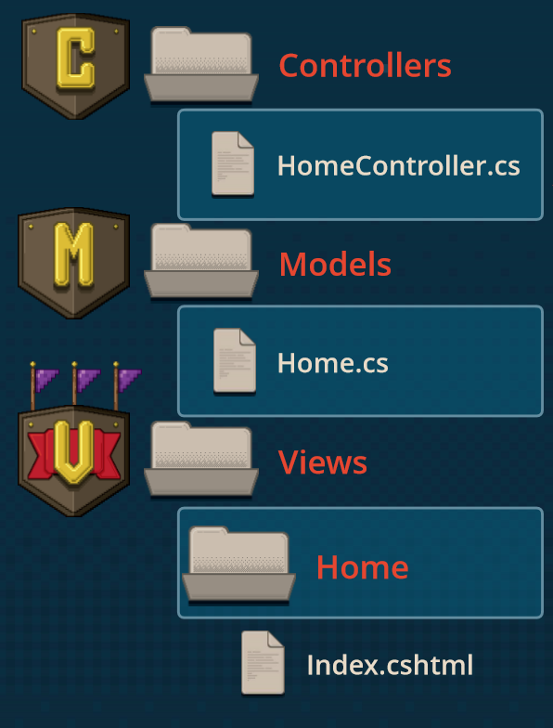
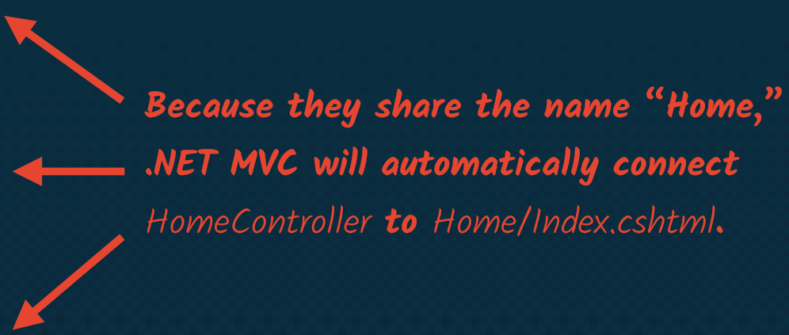
File & Folder namen zijn belangrijk!

Slide 21
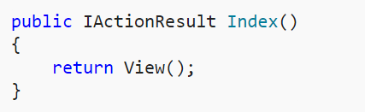
Adding a view
HelloWorldController.cs
Views folder | Add Folder | HelloWorld
Helloworld | Add New Item

Slide 22
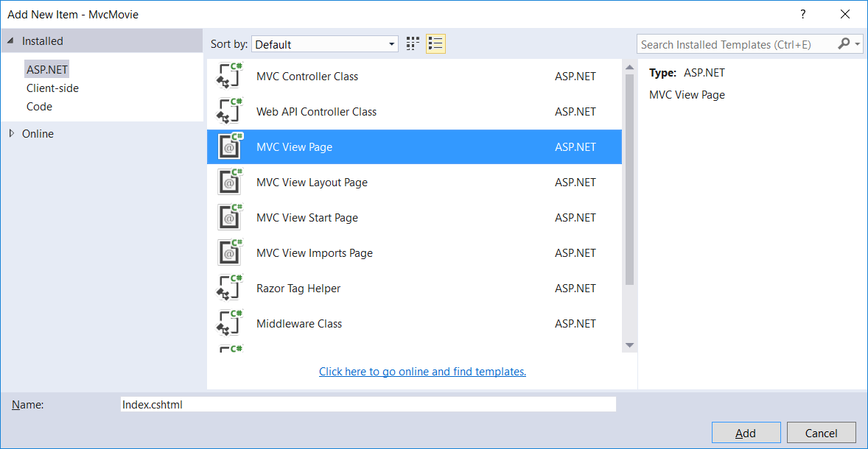
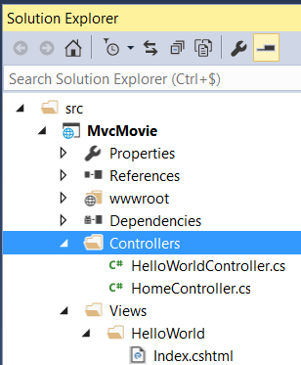
Adding a view

Slide 23
Adding a view
@{
ViewData["Title"] = "Index Title";
}
<h2>Index Header</h2>
<p>Hello from our Index View!</p>
ViewData is een Dictionary object waarmee je data kan doorgeven tussen
Controller en View
Tussen View en View Template
Dictionary object bevat een Key en een Waarde

Slide 24
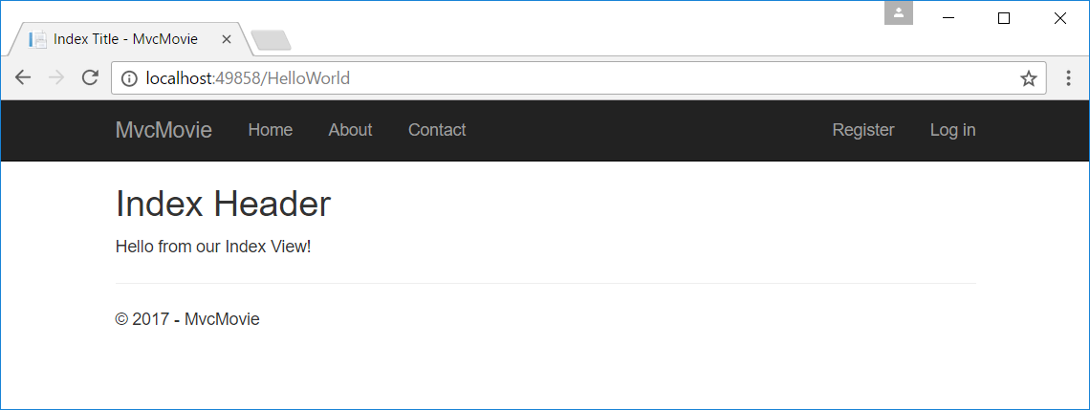
Adding a View

Slide 25
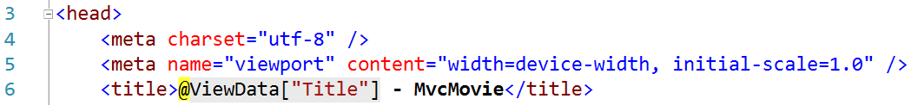
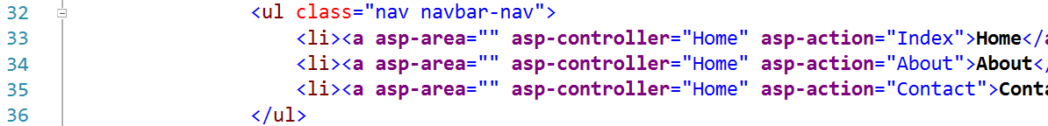
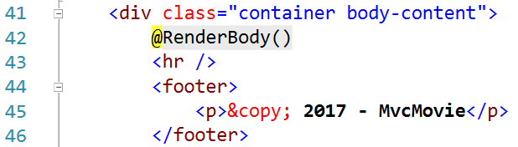
Layout Template
Views/Shared/_Layout.cshtml

Slide 26
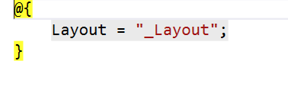
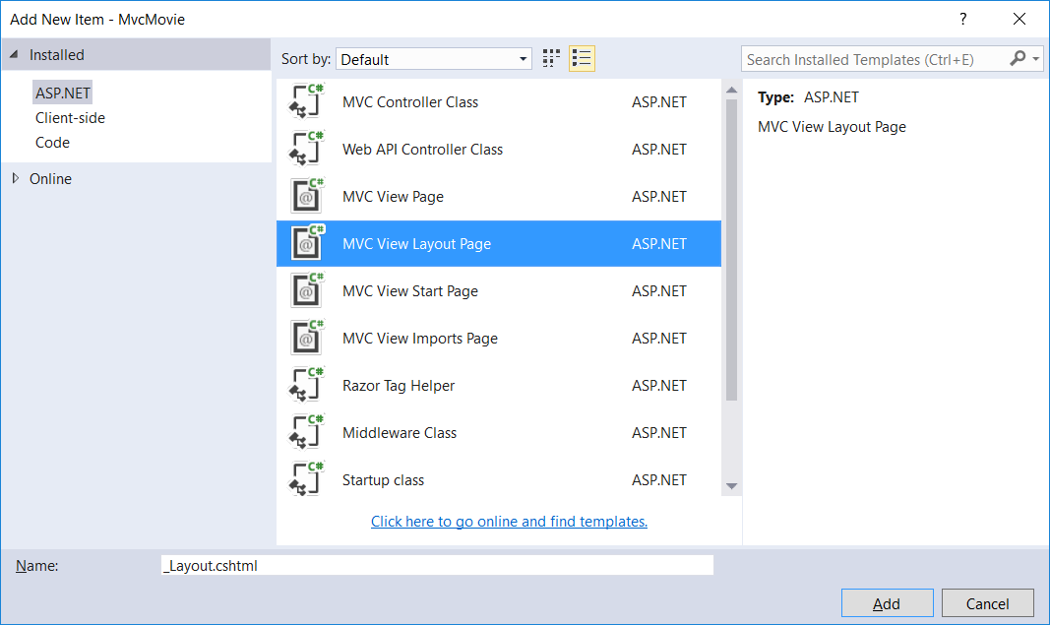
Setting the Layout Template
Views/_ViewStart.cshtml
Verwijder _Layout.cshtml
Shared | Add New Item

Slide 27
Change the template
<!DOCTYPE html>
<html>
<head>
<meta name="viewport" content="width=device-width" />
<title>@ViewData["Title"] - Mvc Movie</title>
</head>
<body>
<h1>Mvc Movie - @ViewData["Title"]</h1>
<div>
@RenderBody()
</div>
</body>
</html>

Slide 28
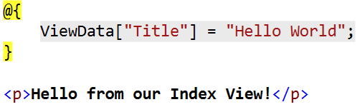
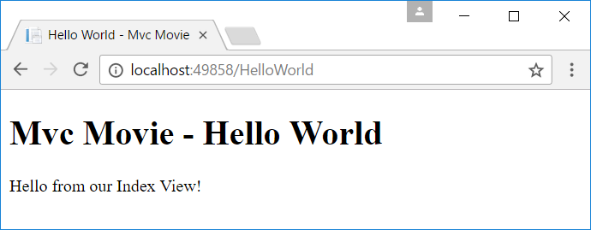
Change the view
Index.shtml

Slide 29
Passing data from the controller to View
HelloWorldController
Extra View Welcome.cshtml
public IActionResult Welcome(string name, int numTimes = 1)
{
ViewData["Message"] = "Hello " + name;
ViewData["NumTimes"] = numTimes;
return View();
}
@{
ViewData["Title"] = "Welcome";
}
<ul>
@for (int i = 0; i < (int)ViewData["NumTimes"]; i++)
{
<li>@ViewData["Message"]</li>
}
</ul>

Slide 30
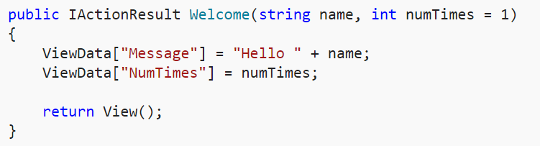
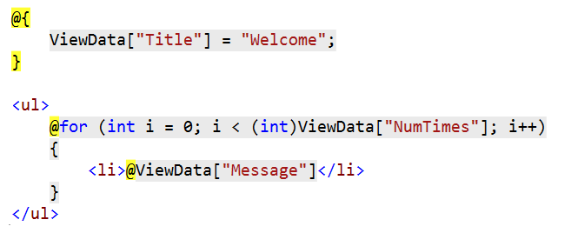
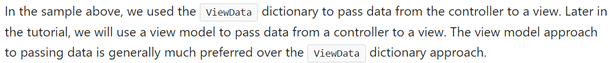
Passing Data from Controller to View

Slide 31
ASP.NET MVC Views
.cshtml
bevatten
Html <html>
Razor @{ var naam = "Jef"; }
HTML helpers @Html.ActionLink("Movies", "List", "Movies")
TAG helpers <a asp-controller="Movies" asp-action="List">Movies</a>

Slide 32
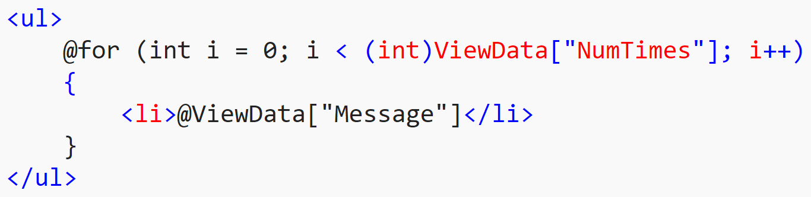
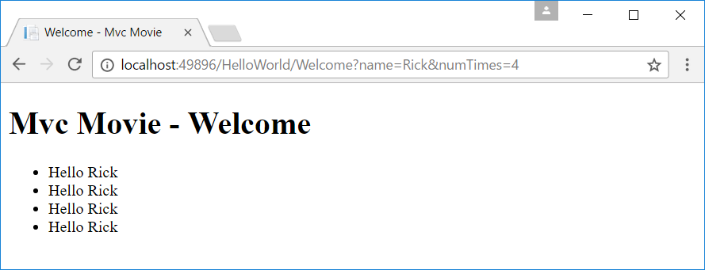
@ Razor

Slide 33
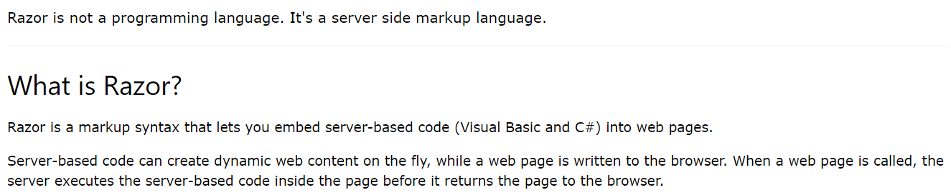
What is razor?

Slide 34
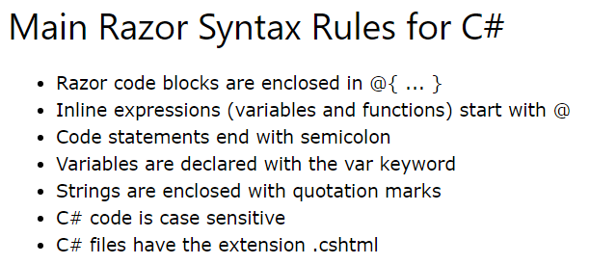
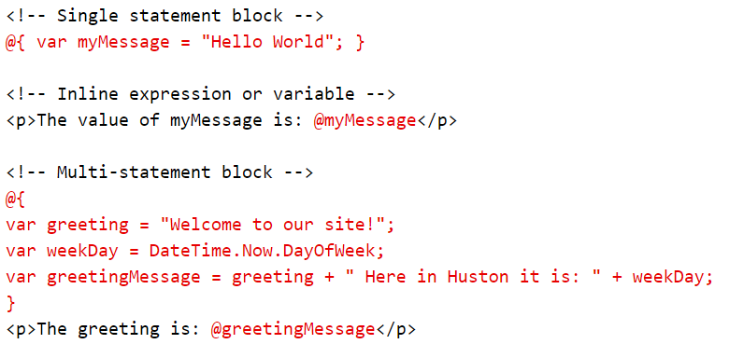
Razor Syntax

Slide 35
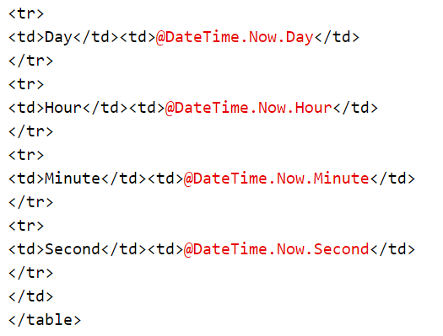
Razor Expressions: @ (with haakjes)

Slide 36
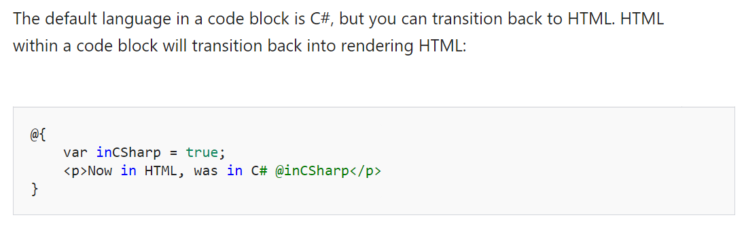
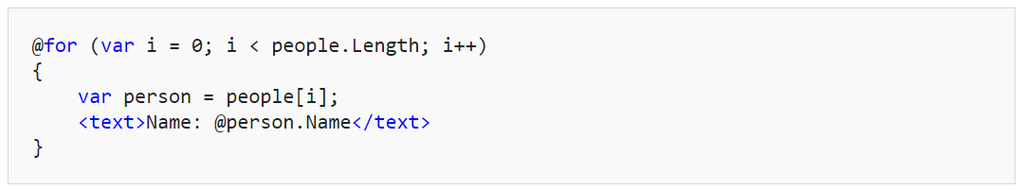
transitions

Slide 37
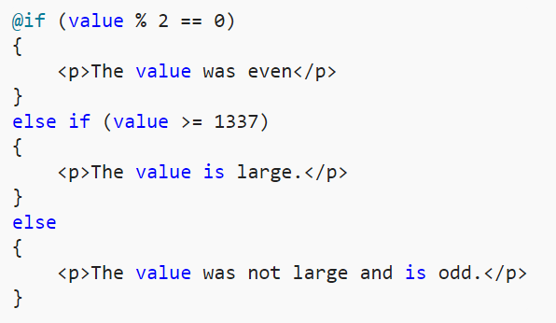
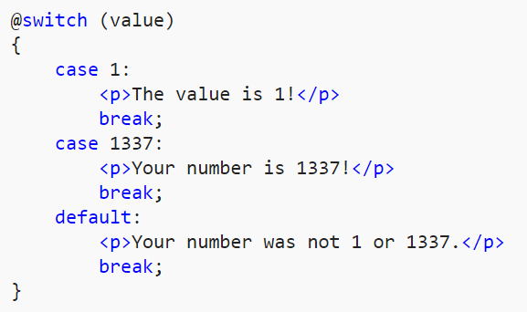
Control structures

Slide 38
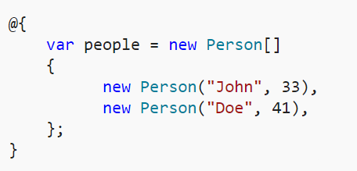
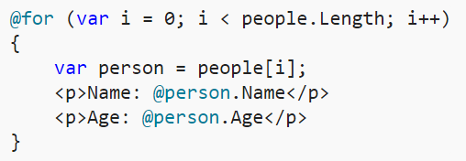

Looping

Slide 39
HTML & TAG Helpers
HTML Helper
@Html.ActionLink("Movies", "List", "Movies")
TagHelper
<a asp-controller="Movies" asp-action="List">Movies</a>
Output in browser
<a href="/Movies/List">Movies</a>

Slide 40
URL Helper (nodig tijdens de oefening)
@Html.ActionLink("Movies", "List", "Movies")
⇨Output in browser
<a href="/Movies/List">Movies</a>
@Url.Action("Movies", "Detail", new { id = 6 })
⇨ Output in browser
/Movies/Detail/6

Slide 41


Home/Index.cshtml
@{
ViewData["Title"] = "Main Menu";
}
<h2>Les 1: Inleiding</h2>
<a asp-controller="HelloWorld" asp-action="Index">Hello World</a><br />
<a asp-controller="HelloWorld" asp-action="Welcome"
asp-route-name="Rick" asp-route-numTimes="5">Welcome</a><br />

Slide 42

HTML & Tag Helpers (later meer)

